Slide 1
Linear and polynomial Regression
Definition
Explanation

Slide 2
Linear regression
Given data
X axis- year Experience
Y axis – salary
With respect to Shown in fig
Years Experience | Salary
1.1 | 39343
1.3 | 46205
1.5 | 37731
2 | 43525
2.2 | 39891
2.9 | 56642
3 | 60150
3.2 | 54445
3.2 | 64445
3.7 | 57189
3.9 | 63218
4 | 55794
4 | 56957
4.1 | 57081
4.5 | 61111
4.9 | 67938
5.1 | 66029
5.3 | 83088
5.9 | 81363
6 | 93940
6.8 | 91738
7.1 | 98273
7.9 | 101302
8.2 | 113812
8.7 | 109431
9 | 105582
9.5 | 116969
9.6 | 112635
10.3 | 122391
10.5 | 121872

Slide 3
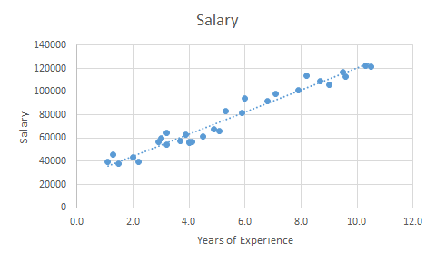
Applied linear regression
Under fit
Straight line – y=mx+c
M= slope
C= y intercept
Underfitting occurs when a model is too simplistic to capture the complexities of the data. It fails to learn the training data effectively.
It results from using an overly simple model or insufficient features.
High Bias (Underfitting): When a model is too simplistic, it fails to capture the underlying patterns in the data. It performs poorly on both training and test data.
Y=mx+c
Y intercept

Slide 4
Overfit
In this fig high bias and low variance
There for getting much complicated
Overfitting occurs when a model learns the training data too well, capturing not only the underlying pattern but also the noise and random fluctuations present in the data.
It happens when the model is too complex or has too many parameters relative to the amount of training data.
High Variance (Overfitting): A model with high variance fits the training data too closely, capturing noise and random fluctuations. However, it performs poorly on unseen test data.

Slide 5
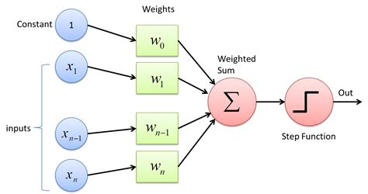
Bias-Variance Tradeoff:
The bias-variance tradeoff is the balance between a model’s ability to minimize bias and variance. It’s crucial for generalization to new, unseen data.
Tradeoff: An algorithm can’t be both overly complex (high variance) and too simple (high bias) simultaneously. We aim for the sweet spot in between.
The best model lies at the tradeoff point, where the total error (bias + variance) is minimized.

Slide 6
Overfit
In this fig high bias and low variance
There for getting much complicated
Overfitting occurs when a model learns the training data too well, capturing not only the underlying pattern but also the noise and random fluctuations present in the data.
It happens when the model is too complex or has too many parameters relative to the amount of training data.

Slide 7
Medium fit
X axis- year Experience
Y axis – salary
With respect to Shown in fig

Slide 8
Polynomial regression
Given data
X axis- year Experience
Y axis – salary
With respect to Shown in fig
Level | Salary
1 | 45000
2 | 50000
3 | 60000
4 | 80000
5 | 110000
6 | 150000
7 | 200000
8 | 300000
9 | 500000
10 | 1000000

Slide 9
First apply liner regression if it possible to get best out put or not

Slide 10
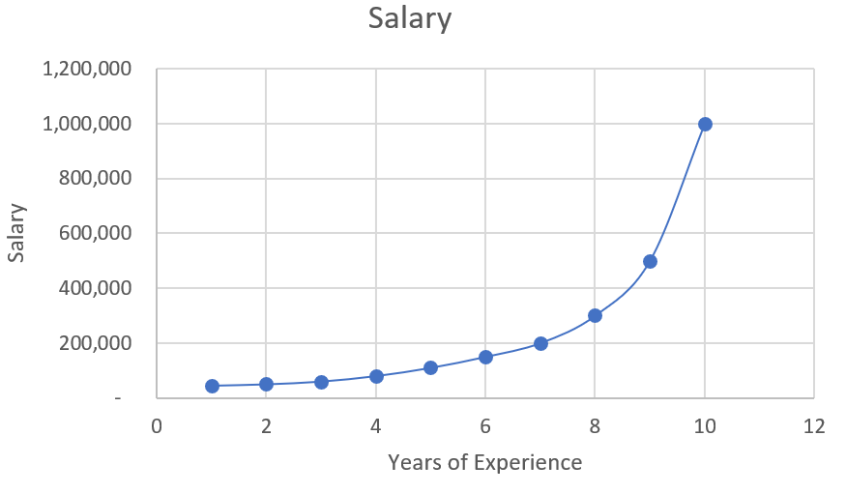
Applied polynomial regression
Line – y = a₁x¹+ a₂x²+ a₃x³………..+ a_{n}x^{n}
a₁, a_{2,} a_{3,………} a_{n}= parameters can optimize
x¹, x², x³,….. x^{n}= independent variable
y = dependent variable
In this fig high bias and low variance
There for its best way to the out put also accuracy
https://www.youtube.com/watch?v=Ar6CtkGvS-A

Slide 11
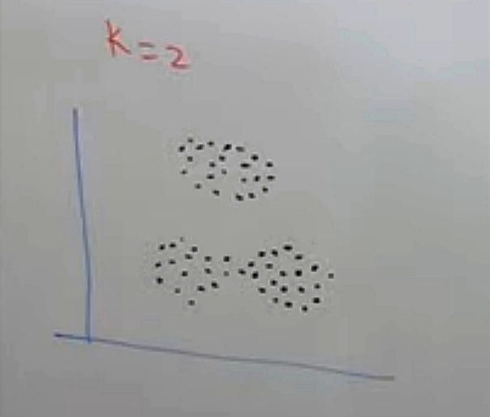
K-mean Algorithm
To divide the data into groups also called as clusters
Select the k value
Initialize the centroid randomly
Find the distance of the pts from centroid by using Euclidean distance
Select the groups or cluster & find the mean value
Repeat 3rd & 4th steps till no movement of pts observed

Slide 12
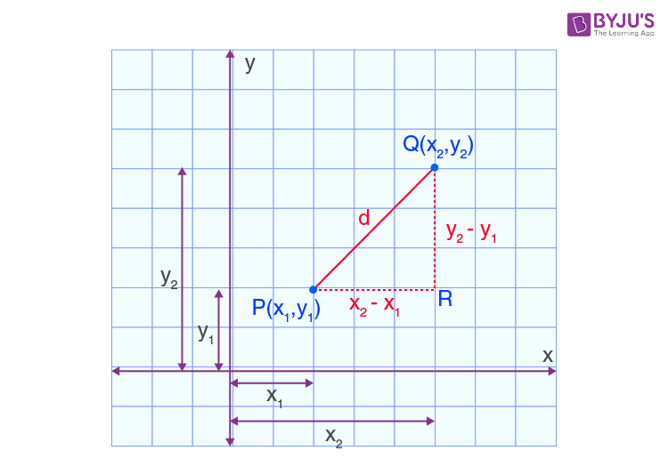
Euclidean distance
Hypotenuse² = Base² + Perpendicular²
PQ² = PR² + QR²
Therefore, d² = (x₂ – x₁)² + (y₂ – y₁)²
d =√[(x₂ – x₁)² + (y₂ – y₁)²]

Slide 13
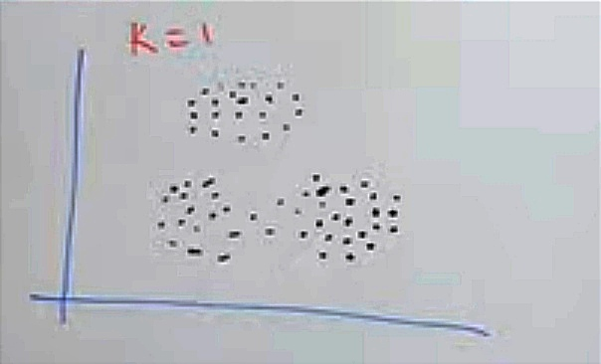
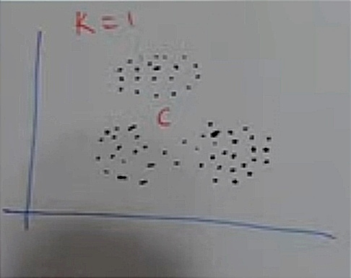

To Select k using elbow method
By using data dived into cluster is k=1
Calculate the distance to centroid and square it
Then find sum of square to nearest centroid
SSNC=$\sum_{i=1}^{n}{{\left(x_{i}−C_{nearest}\right)}^{2}}$

Slide 14
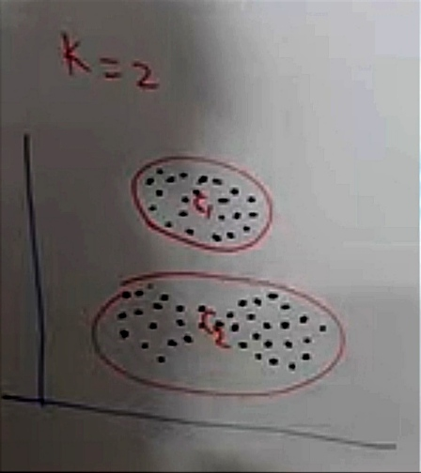
By using data dived into cluster is k=2

Slide 15
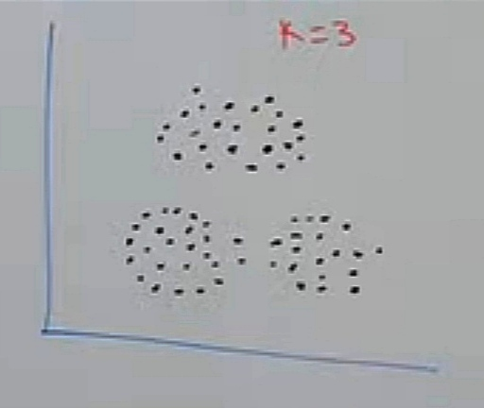
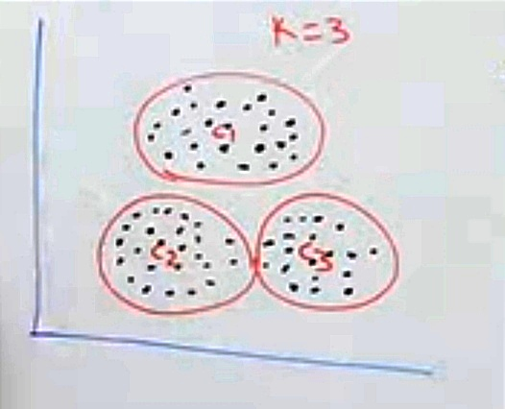
By using data dived into cluster is k=3
K value increase no of the distance to centroid is decreases

Slide 16
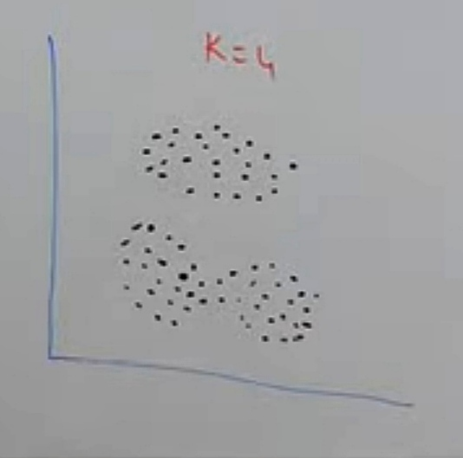
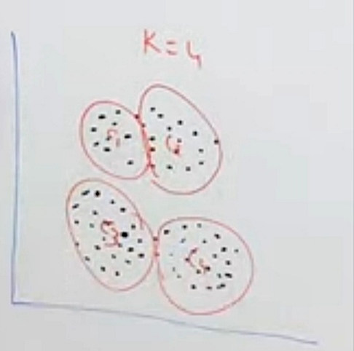
By using data dived into cluster is k=4

Slide 17
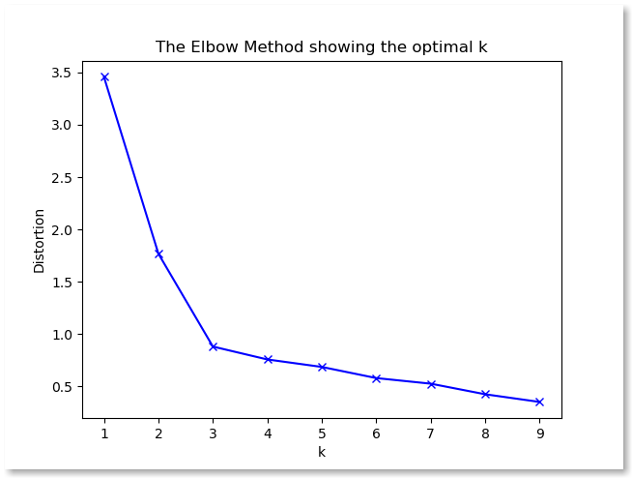
After finding k values
Plot a graph
X axes is k values
Y axes is sum of square to distance
The best k value is
Where the sudden decrease in the SSD

Slide 18
Bag of words
Sent 1 ~ He is a good boy
Sent 2 ~ She is a good girl
Sent 3 ~Boy & Girl are good
lowering the sentence
Stop key words
Sent 1 ~ good boy
Sent 2 ~ good girl
Sent 3 ~boy girl good
Vectors BOW
Words | Frequency
Good | 3
Boy | 2
Girl | 2
 | f₁ | f₂ | f₃
 | good | boy | Girl | o/p
Sent 1 | 1 | 1 | 0
Sent 2 | 1 | 0 | 1
Sent 3 | 1 | 1 | 1

Slide 19

Term Frequency & Inverse document frequency(TF & IDF)
Sent 1 ~ good boy
Sent 2 ~ good girl
Sent 3 ~boy girl good
Term Frequency$=\frac{no of rep of words in sentence}{no of words in sentence}$
 | Sent 1 | Sent 2 | Sent 3
Good | 1/2 | 1/2 | 1/3
Boy | 1/2 | 0 | 1/3
girl | 0 | 1/2 | 1/3
Words | Frequency
Good | 3
Boy | 2
Girl | 2

Slide 20

Term Frequency TF*IDF
IDF$=log⁡(\frac{no of sentence}{no of sentences containing words })$
 | Sent 1 | Sent 2 | Sent 3
Good | 1/2 | 1/2 | 1/3
Boy | 1/2 | 0 | 1/3
girl | 0 | 1/2 | 1/3
 | f₁ | f₂ | f₃ | o/p
 | good | boy | Girl
Sent 1 | 0 | ½*log(3/2) = 0.03 | 0
Sent 2 | 0 | 0 | ½*log(3/3) = 0.03
Sent 3 | 0 | ½*log(3/2) = 0.03 | ½*log(3/2) = 0.03
Words | IDF
Good | log(3/3)=0
Boy | log(3/2)=0.176
girl | log(3/2)=0.176

Slide 21
https://towardsdatascience.com/how-to-build-your-first-spam-classifier-in-10-steps-fdbf5b1b3870

Slide 22
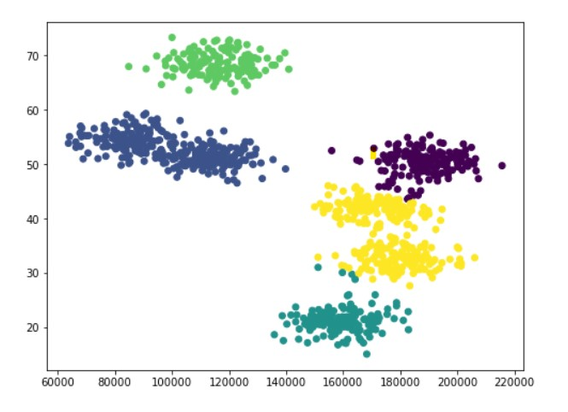
KNN (K-Nearest - Neighbours)
X-axis = salary, y-axis = age
Scattering the data
K means creates clusters around many centroids
We'll use k-means to rediscover these clusters in unsupervised learning
K = 5 means 5 centroid
Introduced new data point which doesn't move means fix
Predict by using distance and, calculating special distance using Euclidean distance
KNN is supervised (predicting)

Slide 23
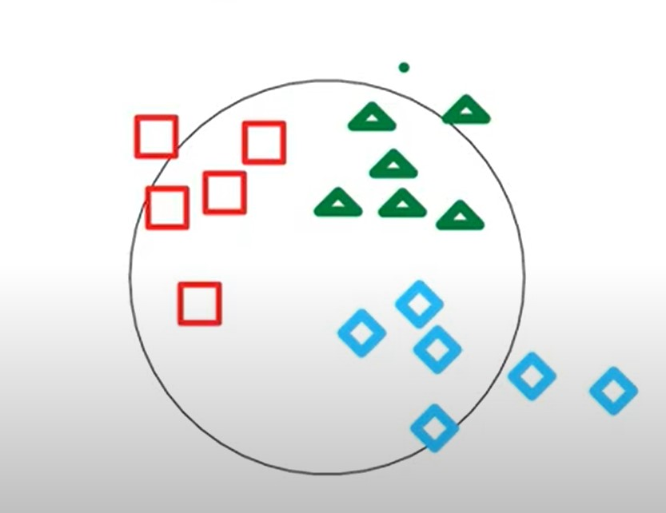
KNN we define distance metric between the items in your dataset, and find the K closest items. These closest items sort of "vote" on which category the new item should belong to.
Labelled & categorised data
New category and label to the new data
Ex:- Movie rating>Data>IMDB
List of move >genre
Genre (Action, Adventure, Comedy, Fantasy, Historical, Horror, Romance, Science fiction, thriller.
Users>rating

Slide 24
Movie =
{movie name,
movie ID,
movie genre}
Genre- |0|0|0|1|1|1|0|0|0|0|0|0|0|0|0|0|0|0|0
Represent this in vector
Its also called “1 hot encoding”
User =
{user name,
user ID,
movie rating}
Genre (Action, Adventure, Comedy, Fantasy, Historical, Horror, Romance, Science fiction, thriller.

